Slide 1

Team Green Third Avenue Software Health-Care App Project
Team Members:
Khue Nguyen
Sophia Massie
Jason Kim
Refugio Lopez
Mohammad Amjad Khan

Slide 2
PART 1
Project Integration Management

Slide 3

Which processes will we use for planning the Third Avenue Health app project from an Agile perspective?
We plan to use all processes since they can be translated into an Agile environment.
Develop the project charter
Develop the project management plan
Direct and manage project work
Manage project knowledge
Monitor and control project work
Perform integrated change control
Close the project or phase
Notes:
In terms of Agile, we assume that all the processes are necessary.
Seven processes of project integration management
1. Develop the project charter - A project charter will formally start the project and give a high-level description of the project’s objective and the product.
2. Develop the project management plan - The project management plan is needed since it is where all the requirements will be listed at the start of the project. It allows for consolidation of the other management plans. While the traditional approach requires a WBS, an Agile environment would be developing a work backlog and would involve constant change once we begin. We do need a project management plan, it would just be constantly changing depending on the situation.
3. Direct and manage project work - Using the Scrum method, in place of high-level descriptions of the work to be completed, the team would develop a more detailed list of technical stories and associated tasks to complete during each sprint. The work progress within a sprint can be represented on a sprint board maintained by the ScrumMaster. The sprint board contains a card to represent each task to be worked on during the sprint.
4. Manage project knowledge - Agile approach is collaborative and is enhanced by team members possessing a broad skill base rather than a narrow specialization. (Schwalbe, 2019). In this way, managing project knowledge is handled by each team member. It is up to the project managers and their team to focus on integration of team member’s knowledge. The project managers also should provide opportunities for team members to acquire additional skills.
5. Monitor and control project work - Planning, monitoring, and controlling are all activities that happen in Agile projects.
6. Perform integrated change control - The team members determine how plans and components integrate.
7. Close the project or phase - There has to be the end of the planning phase at some point. While Agile involves constant change, that doesn’t mean we continue forever. It’s important to keep a lesson’s learned log as we end the planning phase of the project to know what works to enhance the collaboration between team members in order to meet goals.

Slide 4
Project Charter Development
Our health care app will take four months to finish
We have a budget of $350,000
Required features include:
A fitness tracker
Medication tracker
User physicians list
User emergency contact list
Health resources
Medical payment tacker

Slide 5
Choosing Project Manager & Project Framework
Project Manager Criteria | Project Framework
The title for a Project Manager using Scrum is ScrumMaster. We chose Eric for his embodiment of the following skills. Skills and qualities: Leadership skills Coordination and communication skills with previous experience flexibility and adaptability experience with delegating responsibilities the ability to interact effectively with key stakeholders A traditional project manager will have authorities over their team members, while a Scrum Master has control over the process and not the team. A project manager will tell each member what to do with authority, but ScrumMasters will facilitate members to coordinate with each other. | The product owner will establish a project framework that will have a product backlog, sprint backlog, and a burndown chart. To establish how the framework will function, the team will do some sprint planning using the capability wish list for the app to develop a sprint backlog. The team works in sprints to complete its work (typically two to four weeks), and have daily Scrum meetings for progress assessing. The oversight and the direction of activities to meet objectives and detailed project planning will be delegated by the team. The ScrumMaster will facilitate collaboration between team members and keep the team focused on timelines and goals. At the sprint end, a sprint review and retrospective will also be facilitated by the Scrum Master The scrum master will utilize techniques from just in time inventory methods of kanban. The team determines how plans and components integrate. When one sprint ends, the team revisits the product backlog and begins working on another chunk.

Slide 6
Researching the Market: Deep Dive of Competing App Health4Me
Health4Me by United HealthCare app allows users to access their health information and their families' health information in one place.
Users can also find healthcare facilities in their area and compare prices.
The app also tracks biometric and fitness data.
Personalized care notifications if missing medical services from lab tests to preventive care reminders.
Features to pay medical bills with a credit card, debit card, back account or health savings account
A digital identification card
Wellness-related resources such as integration with wearable devices.
Our Advantage:
Our app is specifically designed to accommodate a segment of the population that is underserved by health apps. The older generation will engage and use our app more if the usability is tailored specifically for them including text/visual magnification tools and straightforward interfaces.

Slide 7
Kick-Off Meeting Agenda
Introductions of attendees, i.e., product owner, scrum master, development team.
Background of the Health-Care App and its place in the portfolio of Third Avenue Software
Review of project-related documents (i.e. business case, project charter)
Listings of all resources
Discussion of Scrum framework
Discussion of project scope, time, and cost goals
Discussion of product backlog, sprint backlog, and burndown charts.
The Scrum Master keeps track of of any changes that are made within the schedule
Notes:
Conducting a solid kick-off meeting is a crucial step to get projects started on the right track. This meeting will introduce the project and energize team members by clarifying key stakeholders, reviewing project goals, and discussing future plans in an agile environment. The key points of the meeting will include:
Read slide
The meeting should include a list of action items to be sent out in a meeting minutes memorandum. It’s important that stakeholders and team members receive the meeting minutes within a day or so of the kickoff meeting so the next steps in the project are clear.

Slide 8
PART 2
Project Scope Management

Slide 9
Charter Update
Roles and Responsibilities
MVP must be completed by six weeks in:
Features workable state
Can easily see where improvements will happen
Have a feedback loop for improvements
Role | Name | Organization/ Position
ScrumMaster | Eric | Will program the application while keeping track of team progress.
Programmer | Lia | Will program the application with Eric
Marketing | Brianna | Will use healthcare experience to market the app.
Regulatory Manager | Jack | Will monitors the product’s production and ensures compliance to regulations and standard operating procedures
Quality Assurance | Kendra | Will make sure the product’s main features are met with a high standard.

Slide 10
User Stories
External Stakeholders
Internal Stakeholders
As a user, I want a fitness tracker so that I can check my blood pressure and cholesterol quickly.
As a user, I want an emergency list of hospitals so I can find one if something bad happens in a place I’m unfamiliar with.
As a programmer, I want to make sure that the software meets specifications so that we can install it onto phones.
As a regulatory manager, I want to make the app fit health care regulations so that we’re allowed to sell it.
As a user, I want to have a medication tracker so that I can regularly schedule when to take my medication.
As a user, I want an emergency information list so that I can quickly and easily go to the hospital.
As a quality assurance manager, I want to make the app better than others like it so that we can beat out the competition.
As a user, I want an address book so that I can contact my doctors easily.
As a user, I want a resources feature so that I can look up my symptoms and look at medical news.
As a ScrumMaster, I want to keep the team morale and synergy high so that we can create a high-quality product.
As a handicap user, I want accessibility options so that I don’t have issues navigating through it.
As a user, I want a payment feature so that I can see my costs and how to pay them.
As a marketer, I want to make the app known so that customers will be aware once we publish the app.

Slide 11
Technical Stories
External Stakeholders
Internal Stakeholders
The fitness tracker should record the user’s health information, such as cholesterol and blood pressure.
We should implement a GPS to locate hospitals and other health-care venues in the area.
Lia and Eric will make sure the features in the app shouldn’t cause any crashes. It can run better later, just get it working.
Jack will talk with Lia and Eric to make sure to tell them how the app is supposed to fit into healthcare guidelines.
There should be a medication tracker with a calendar and alarm feature. Possibly link it to a healthcare system that hospitals use so doctors can auto input.
In the event the user can’t give information despite needing to go to the hospital, the app should be able to provide information to those doctors if need be.
When each feature in the app is stable, Kendra can compare it to other similar apps and give notes on what to improve.
The app should have an electronic address book to the doctors’ network and other health-care professionals.
The app should have a link to popular online health sites like WebMD and medical research sites.
Eric will go to each team member and make sure while coding the app and facilitate communications to keep everyone on the level.
An accessibility menu should be available from the beginning to allow users to customize the menus for easier use if need be.
A payment system should be implemented with the hospital to show the costs and how to pay them. Options should include payment plans that the hospitals can offer.
Kendra will check on the general feelings of the market in regards to the app and let the rest of the team know what parts are popular in those already established apps.

Slide 12
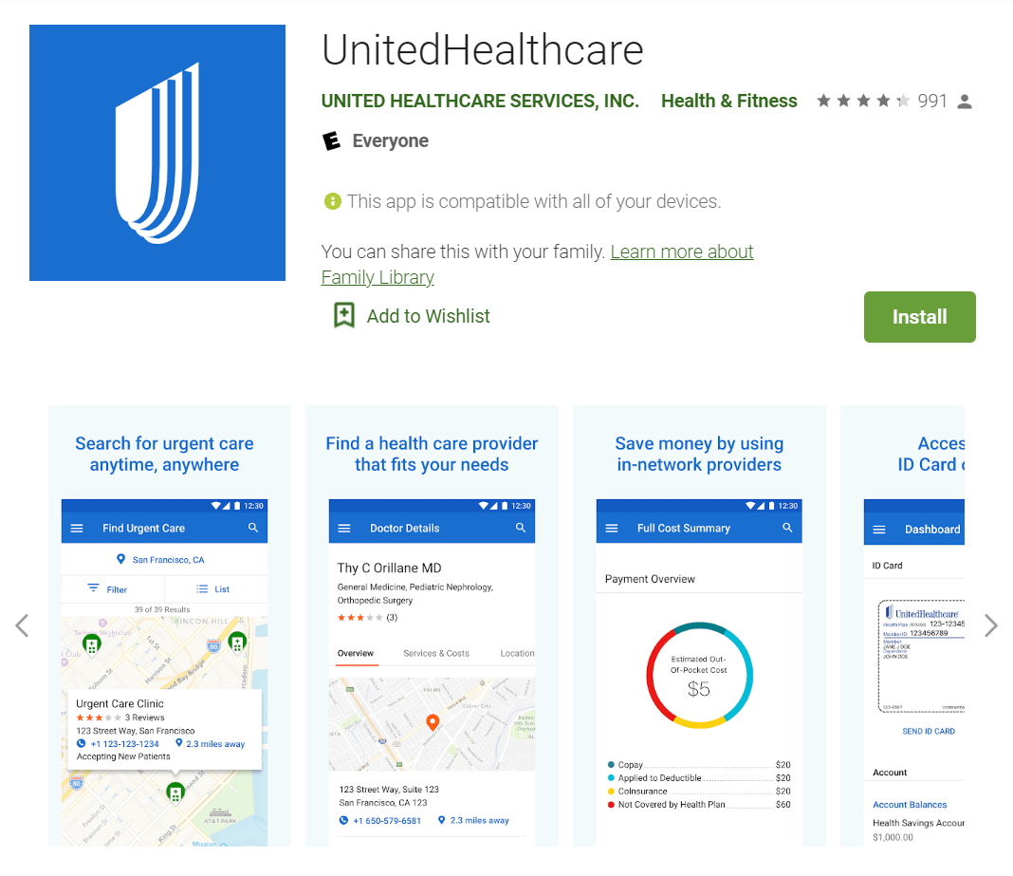
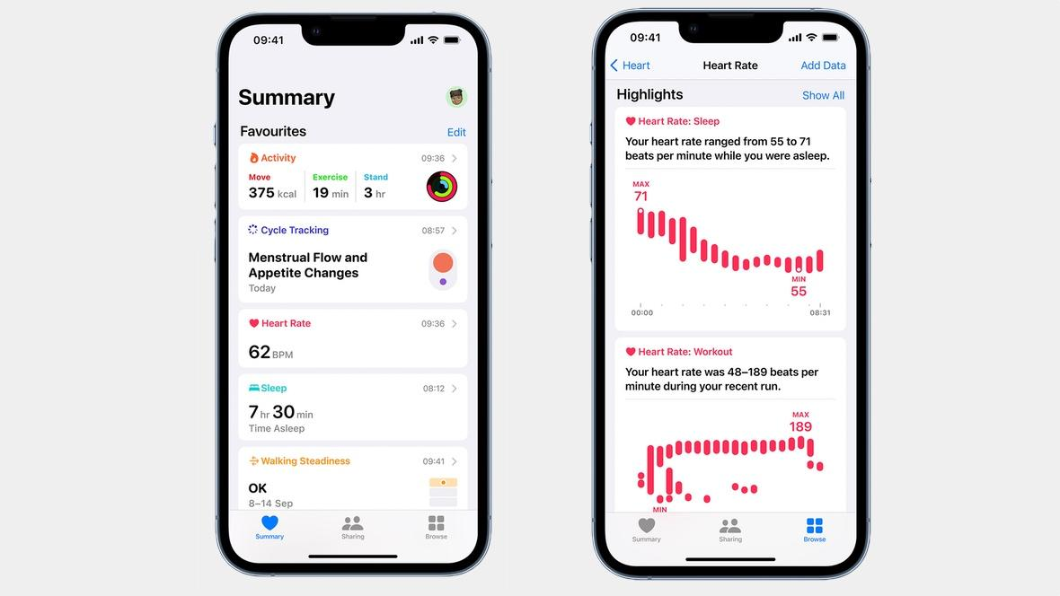


Requirements
Benchmarking
Other apps exist
Look at reviews
Adjust priorities
Focus Groups
Handicap focus group
Gain accessibility data
Check after app iteration

Slide 13
Scope Statement
Product Characteristics and Requirements:
1. Accessible to all users regardless of handicaps.
2. Includes a fitness tracker, medication tracker, electronic address book, emergency information list, resource search, and payment option.
3. A minimum viable product (MVP) will be created in 6 weeks time
4. The app will be monetized.
Project Success Criteria:
1. Everything done under a $350,000 budget
2. A Health app with all features included
3. Each feature will have accessibility options implemented
4. It will have a successful monetization strategy implemented

Slide 14
PART 3
Project Schedule Management

Slide 15
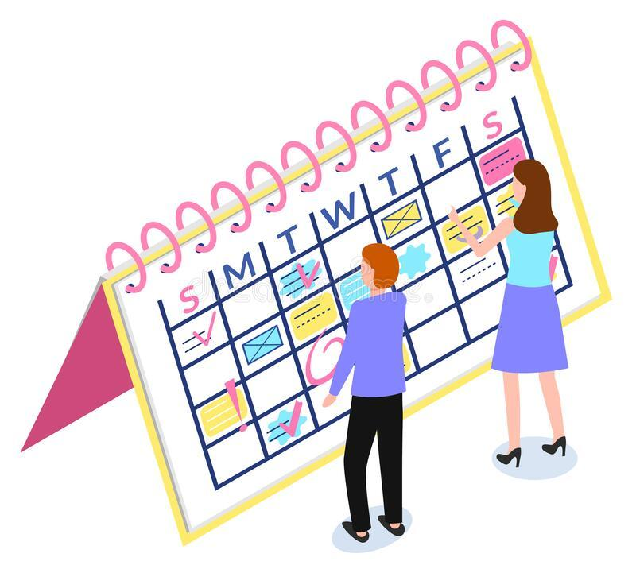
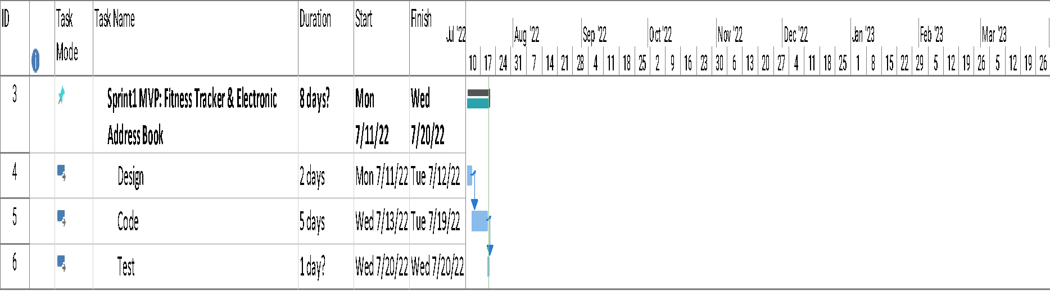
Sprint 1 MVP – 50 Story Points Fitness Tracker & Electronic Address Book

Slide 16

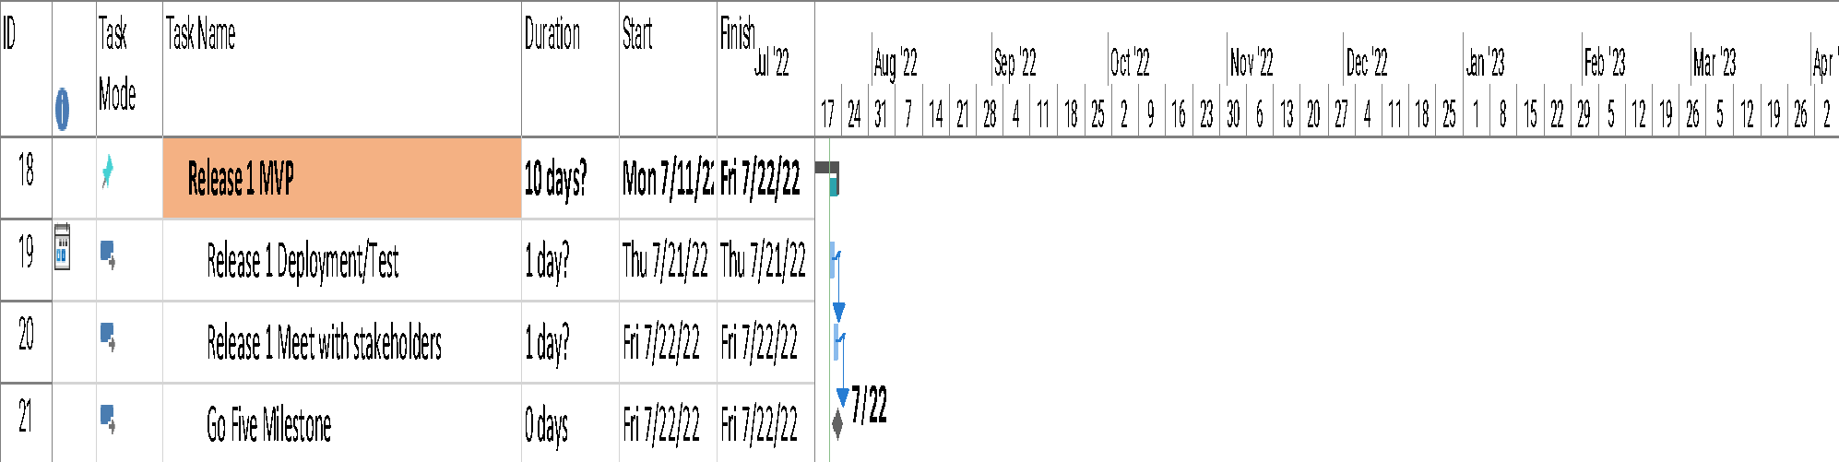
Release 1 MVP & Milestone

Slide 17
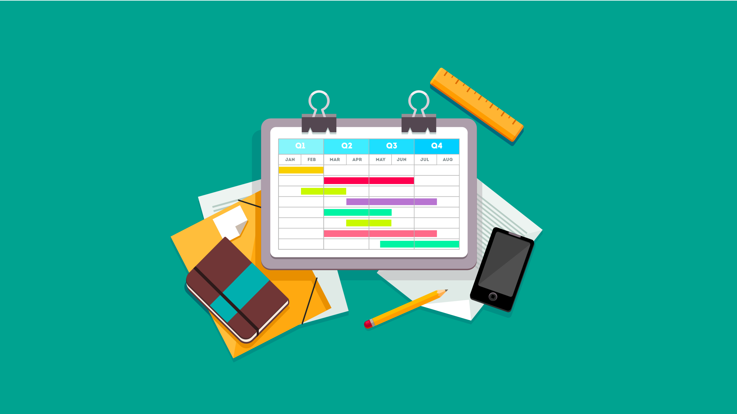
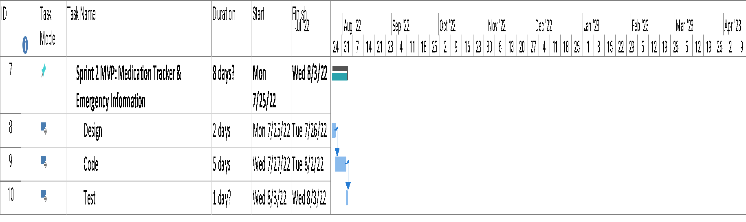
Sprint 2 MVP – 50 Story Points Medication Tracker & Emergency Information

Slide 18
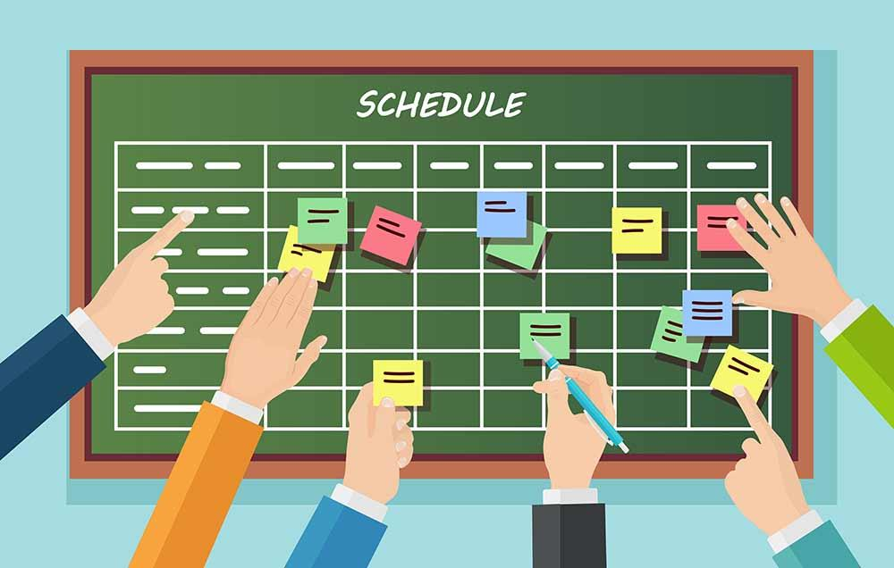
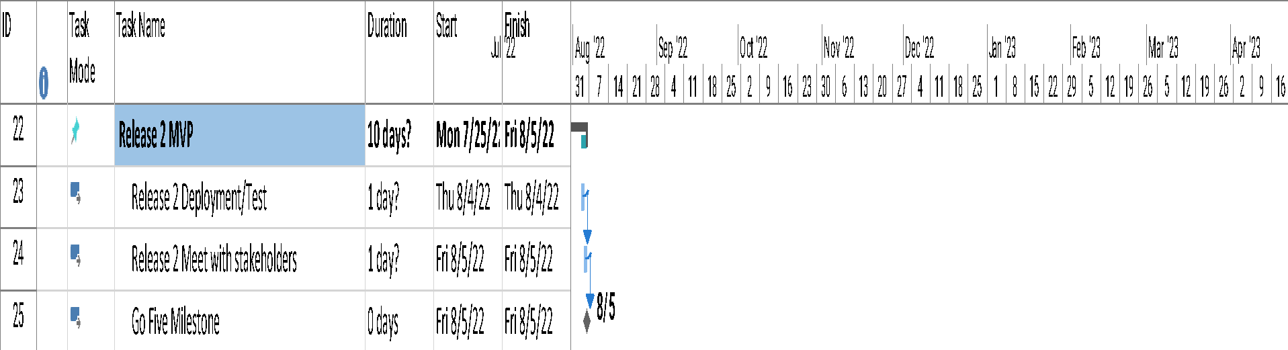
Sprint 2 MVP Release

Slide 19

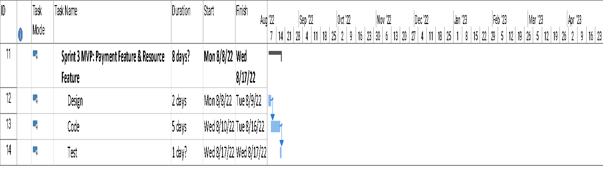
Sprint 3 MVP – 50 Story Points Payment Feature & Resource Feature

Slide 20
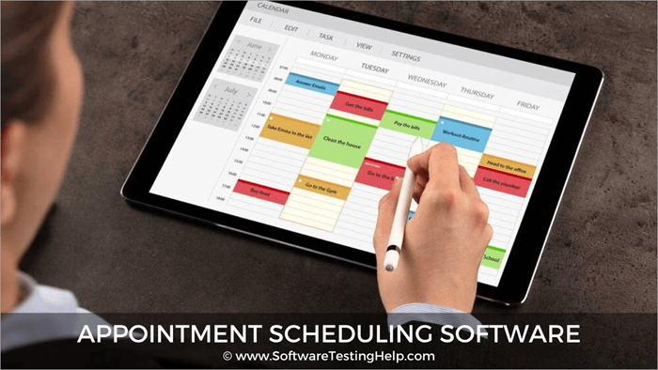
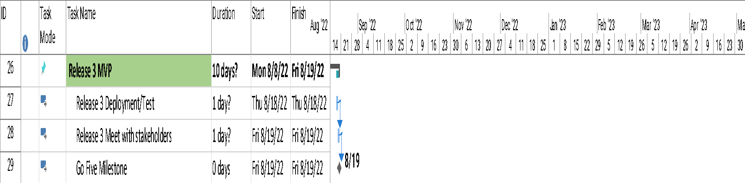
Sprint 3 MVP Release

Slide 21

Schedule & Milestones 7/11/2022 Through 11/16/2022
Jul 24, '22
Jul 24, '22
Jul 24, '22
Jul 24, '22
Jul 24, '22
Jul 24, '22
Jul 24, '22
Jul 24, '22
Jul 24, '22
Jul 24, '22
Jul 24, '22
Jul 24, '22
Jul 24, '22
Jul 24, '22
Jul 24, '22
Jul 24, '22
Jul 24, '22
Jul 24, '22
Jul 24, '22
Jul 24, '22
Jul 24, '22
Jul 24, '22
Jul 24, '22
Jul 24, '22
Jul 24, '22
Aug 7, '22
Aug 7, '22
Aug 7, '22
Aug 7, '22
Aug 7, '22
Aug 7, '22
Aug 7, '22
Aug 7, '22
Aug 7, '22
Aug 7, '22
Aug 7, '22
Aug 7, '22
Aug 7, '22
Aug 7, '22
Aug 7, '22
Aug 7, '22
Aug 7, '22
Aug 7, '22
Aug 7, '22
Aug 7, '22
Aug 7, '22
Aug 7, '22
Aug 7, '22
Aug 7, '22
Aug 7, '22
Aug 21, '22
Aug 21, '22
Aug 21, '22
Aug 21, '22
Aug 21, '22
Aug 21, '22
Aug 21, '22
Aug 21, '22
Aug 21, '22
Aug 21, '22
Aug 21, '22
Aug 21, '22
Aug 21, '22
Aug 21, '22
Aug 21, '22
Aug 21, '22
Aug 21, '22
Aug 21, '22
Aug 21, '22
Aug 21, '22
Aug 21, '22
Aug 21, '22
Aug 21, '22
Aug 21, '22
Aug 21, '22
Sep 4, '22
Sep 4, '22
Sep 4, '22
Sep 4, '22
Sep 4, '22
Sep 4, '22
Sep 4, '22
Sep 4, '22
Sep 4, '22
Sep 4, '22
Sep 4, '22
Sep 4, '22
Sep 4, '22
Sep 4, '22
Sep 4, '22
Sep 4, '22
Sep 4, '22
Sep 4, '22
Sep 4, '22
Sep 4, '22
Sep 4, '22
Sep 4, '22
Sep 4, '22
Sep 4, '22
Sep 4, '22
Sep 18, '22
Sep 18, '22
Sep 18, '22
Sep 18, '22
Sep 18, '22
Sep 18, '22
Sep 18, '22
Sep 18, '22
Sep 18, '22
Sep 18, '22
Sep 18, '22
Sep 18, '22
Sep 18, '22
Sep 18, '22
Sep 18, '22
Sep 18, '22
Sep 18, '22
Sep 18, '22
Sep 18, '22
Sep 18, '22
Sep 18, '22
Sep 18, '22
Sep 18, '22
Sep 18, '22
Sep 18, '22
Oct 2, '22
Oct 2, '22
Oct 2, '22
Oct 2, '22
Oct 2, '22
Oct 2, '22
Oct 2, '22
Oct 2, '22
Oct 2, '22
Oct 2, '22
Oct 2, '22
Oct 2, '22
Oct 2, '22
Oct 2, '22
Oct 2, '22
Oct 2, '22
Oct 2, '22
Oct 2, '22
Oct 2, '22
Oct 2, '22
Oct 2, '22
Oct 2, '22
Oct 2, '22
Oct 2, '22
Oct 2, '22
Oct 16, '22
Oct 16, '22
Oct 16, '22
Oct 16, '22
Oct 16, '22
Oct 16, '22
Oct 16, '22
Oct 16, '22
Oct 16, '22
Oct 16, '22
Oct 16, '22
Oct 16, '22
Oct 16, '22
Oct 16, '22
Oct 16, '22
Oct 16, '22
Oct 16, '22
Oct 16, '22
Oct 16, '22
Oct 16, '22
Oct 16, '22
Oct 16, '22
Oct 16, '22
Oct 16, '22
Oct 16, '22
Oct 30, '22
Oct 30, '22
Oct 30, '22
Oct 30, '22
Oct 30, '22
Oct 30, '22
Oct 30, '22
Oct 30, '22
Oct 30, '22
Oct 30, '22
Oct 30, '22
Oct 30, '22
Oct 30, '22
Oct 30, '22
Oct 30, '22
Oct 30, '22
Oct 30, '22
Oct 30, '22
Oct 30, '22
Oct 30, '22
Oct 30, '22
Oct 30, '22
Oct 30, '22
Oct 30, '22
Oct 30, '22
Nov 13, '22
Nov 13, '22
Nov 13, '22
Nov 13, '22
Nov 13, '22
Nov 13, '22
Nov 13, '22
Nov 13, '22
Nov 13, '22
Nov 13, '22
Nov 13, '22
Nov 13, '22
Nov 13, '22
Nov 13, '22
Nov 13, '22
Nov 13, '22
Nov 13, '22
Nov 13, '22
Nov 13, '22
Nov 13, '22
Nov 13, '22
Nov 13, '22
Nov 13, '22
Nov 13, '22
Nov 13, '22
Start 7/11
Sprint1 MVP: Fitness Tracker & Electronic Address Book 7/11 - 7/20
Finish 11/16
Sprint1 MVP: Fitness Tracker & Electronic Address Book 7/11 - 7/20
Release 1 Deployment/Test 7/21
Release 1 Deployment/Test 7/21
Release 1 Meet with stakeholders 7/22
Release 1 Meet with stakeholders 7/22
Sprint 2 MVP: Medication Tracker & Emergency Information 7/25 - 8/3
Sprint 2 MVP: Medication Tracker & Emergency Information 7/25 - 8/3
Release 2 Deployment/Test 8/4
Release 2 Deployment/Test 8/4
Release 2 Meet with stakeholders 8/5
Release 2 Meet with stakeholders 8/5
Sprint 3 MVP: Payment Feature & Resource Feature 8/8 - 8/17
Sprint 3 MVP: Payment Feature & Resource Feature 8/8 - 8/17
Release 3 Deployment/Test 8/18
Release 3 Deployment/Test 8/18
Release 3 Meet with stakeholders 8/19
Release 3 Meet with stakeholders 8/19
Sprint 4: Emergency List for Storing Vital Phone Numbers 8/22 - 9/8
Sprint 4: Emergency List for Storing Vital Phone Numbers 8/22 - 9/8
Release 4 Development/Test 9/9 - 9/14
Release 4 Development/Test 9/9 - 9/14
Release 4 Deployment 9/15 - 9/19
Release 4 Deployment 9/15 - 9/19
Sprint 5: Emergency List for Storing Personal Information & Usability 9/20 - 10/7
Sprint 5: Emergency List for Storing Personal Information & Usability 9/20 - 10/7
Release 5 Development/Test 10/10 - 10/13
Release 5 Development/Test 10/10 - 10/13
Release 5 Deployment 10/14 - 10/18
Release 5 Deployment 10/14 - 10/18
Sprint 6: Usability 10/19 - 11/7
Sprint 6: Usability 10/19 - 11/7
Release 6 Development/Test 11/8 - 11/11
Release 6 Development/Test 11/8 - 11/11
Release 6 Deployment 11/14 - 11/16
Release 6 Deployment 11/14 - 11/16
Go Five Milestone 7/22
Go Five Milestone 7/22
Go Five Milestone 8/5
Go Five Milestone 8/5
Go Five Milestone 8/19
Go Five Milestone 8/19
Go Five Milestone 9/19
Go Five Milestone 9/19
Go Five Milestone 10/18
Go Five Milestone 10/18
Go Five Milestone 11/16
Go Five Milestone 11/16

Slide 22

Scrum 1 MVP Schedule
Task Day1 Day2 Day3 Day4 Day5 Day6 Day7 Day8 Day9 Day10
Design 8 10
Code 12 10 8 7 9
Test 10
Deploy 8
Meet Stakeholder 7

Slide 23

Scrum 1 MVP, Work Assignments
Sprint 1 MVP, Work Assignment Schedule:
Project Manager: Design, 4 hours; Code, 8 hours; Test, 2 hours; Deploy, 2 hours; Meet Stakeholder, 2 hours.
Eric, Programmer: Design, 7 hours; Code, 22 hours; Test, 3 hours; Deploy, 2 hours; Meet Stakeholders, 1 hours.
Lia, Programmer: Design, 7 hours; Code, 16 hours; Test, 3 hours; Deploy, 1 hour.
Brianna, Marketing: Deploy, 1 hour; Meet Stakeholders, 1 hour.
Jack, Regulatory Manager: Deploy, 1 hour; Meet Stakeholders, 1 hour.
Kendra, Quality Assurance Manager: Deploy, 1 hour; Meet Stakeholders, 1 hour.
Aziz, Quality Assurance Tester: Test, 2 hours.
Barry, Accounting Staff: Meet Stakeholders, 1 hour.

Slide 24
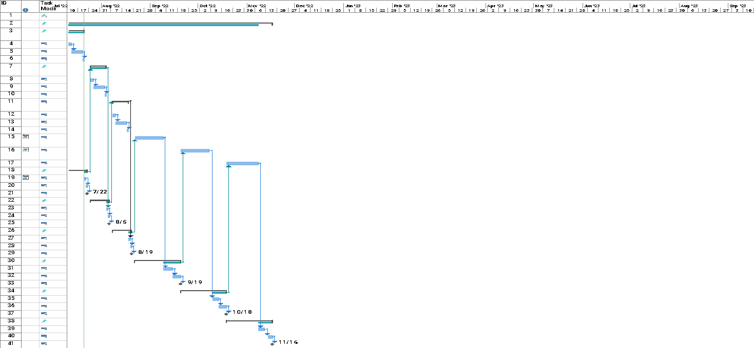
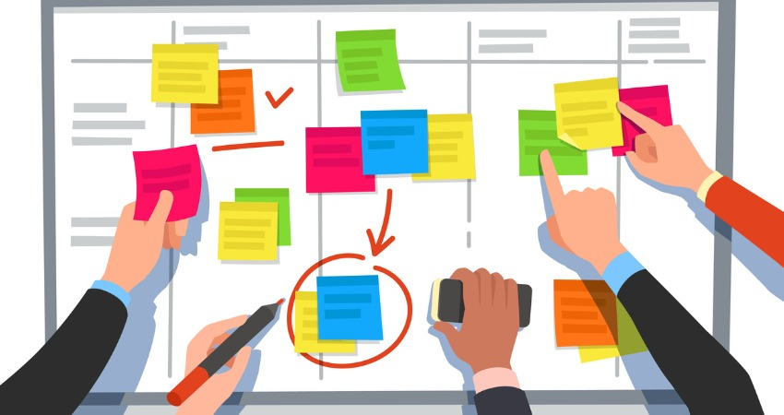
Gantt Chart 7/11/2022 through 11/16/2022

Slide 25
PART 4
Project Cost and Quality Management

Slide 26
Production Cost
Production Cost per Story Point = $1200
Fitness Tracker | Medication Tracker | Electronic Address Book | Emergency Contact List | Emergency Information List | Resources Feature | Payment Feature | Usability Issues
30 Story Points | 30 Story Points | 20 Story Points | 60 Story Points | 20 Story Points | 10 Story Points | 40 Story Points | 40 Story Points
$36,000 | $36,000 | $24,000 | $72,000 | $24,000 | $12,000 | $48,000 | $48,000
Grand Total = $300,000

Slide 27
Earned Values
Figures received:
PV = $105,000
EV = $122,000
AC = $105,000
BAC = $350,000
Calculations:
CV = $17,000
SV = $17,000
CPI = 1.162
SPI = 1.162
EAC = $301,205

Slide 28
QUALITY REQUIREMENTS
When recording blood pressure or cholesterol levels readings, will the app accept readings that are invalid or abnormal?
Will there be an under and above limit where if the reading goes beyond, the app will prompt a warning?
Can users set a range for goal calories intake per day?
When users enter exercise and time of exercise, will the app save the information for suggestions next time?
Testing for Fitness Tracker
Testing for Medication Tracker
Testing for Physicians List
Testing for Emergency List

Slide 29
QUALITY REQUIREMENTS
When users enter medication names, there should be a list of suggested medication names for users to easily pick the right name. Does the list appear after two/three letters or more?
Can the user go back to previous days on the calendar to edit their medication information?
Is there a reminder feature for the alarm? Can users set multiple alarms a day for one medication?
When entering the medication schedule, there should be an option to choose “everyday”, or “every” and a drop-down list of all the days of the week. Does this feature allow users multiple choices?
Testing for Fitness Tracker
Testing for Medication Tracker
Testing for Physicians List
Testing for Emergency List

Slide 30
QUALITY REQUIREMENTS
When searching for nearest physicians, does the app display physicians in an order of closest for furthest location?
When physicians list is displayed, there should be a filter to select in-network and/or out-of-network physicians. Does the list display in-network physicians by default?
Upon clicking on the listed physicians, there should be information of the physician and a phone number to call. Does clicking on the phone number prompt the app to activate the call function of the device the user is using?
Does the physician list have a filter for people with the same name?
Does the physician list have a filter for specialization?
Testing for Fitness Tracker
Testing for Medication Tracker
Testing for Physicians List
Testing for Emergency List

Slide 31
QUALITY REQUIREMENTS
Do all the data-entry fields accept text without problems?
Is it possible to enter nonsensical data in a field?
Does the software automatically move the user from one entry field to the next? Does the cursor always appear in the next entry field as a means of visual feedback for the user?
As soon as the user enters and saves an address, an interactive GPS map should become available in a new window, with voice and text directions. Does the window appear? Does it appear immediately?
When you slide your finger to create the effect of movement within the map, does the software redraw in a timely manner?
Testing for Fitness Tracker
Testing for Medication Tracker
Testing for Physicians List
Testing for Emergency List

Slide 32
PART 5
Project Resource and Communication Management

Slide 33
Adjusting Resources
Adjustments based on feedback from managers about project scheduling
Utilize user stories and technical stories to inform the two-week sprint schedule
Adjust sprint schedules so that Electronic Address book for physicians and pharmacies is in sprint 1 along with Emergency Contact feature as they share similar contact book features and coding structure
This resource leveling takes heavy lifting from the development team so they can assist with other company work
Giving the project a longer deadline to make sure it reaches user and stakeholder quality standards
Notes:
Additional Part 2 Speaking Notes
Good communication is considered one of the strengths of the agile approach when compared with more traditional methods of project management. Why is this so? Explain your answer in three to four paragraphs.
The agile approach to project management requires all communications be up to date, easily available, and reviewed regularly with stakeholders (Schwalbe). The structure inherently requires regular contact with the entire team and transparency between members’ progress and expectations. Good communication built into the project management framework then allows for a high acceptance for feedback and change. In turn, this allows constant feedback from team members and stakeholders ultimately creating a better output within the project timeline. (Carr)
IT projects typically require a lot of adaptability because the timeline and framework for the project may not necessarily be linear. Competitors release competing products, stakeholder expectations change, and user testing offers unexpected feedback. As requirements change to better the product overall, rapid, and effective notification of changes to the team is essential. All projects require great communication but with an agile perspective, it simply is not an option to deprioritize communications and communication skills within the team or the whole structure and schedule falls apart. Testers don’t know what they’re looking for, programmers don’t know features to prioritize, and stakeholders are unaware of resource constraints and change requests.
Dependencies within phases of complex projects require that the team in is in constant communication with each other so they can plan their individual schedules. If a team member is working on a phase that cannot begin until another phase is complete, the progress of the phase before must be communicated regularly in order for other team members to know when to expect to start their work. Ideally in planning a project with an agile approach fully embraced by the company culture, surprises and confusion are minimized throughout the life of the project.
No matter the project, communication and team cooperation is the key to meeting time, scope, and budget constraints, but more importantly, great communication frameworks and skills build solid products with input and feedback from all invested.

Slide 34
PROGRESS REPORT
Reporting Period: 7/11/2022 – 7/23/2022
Work completed this reporting period: Fitness Tracker still in development phase. Quality requirements for fitness tracker and electronic written out and communicated to team to be used once we get to the testing phase.
Work to complete next reporting period: Continue working through Sprint 1. Submit change request to switch features in this sprint with the next so that fitness and medicine tracker features are in sprint 1 and emergency contact and electronic address book are in sprint 2.
What’s going well and why: Fitness tracker design and coding progress is on track.
What’s not going well and why: Features in Sprint 1 do not have enough similarities to streamline the work for the development team. Development team having issues with time management as they switch between the fitness tracker coding and the electronic address book. They also have to manage other work for the company. Development team overallocated in this sprint.
Suggestions/Issues: Utilize resource leveling by switching features in Sprint 1 and Sprint 2 so features have more coding similarities.
Project changes Switch features to address in sprint 1 from Fitness Tracker and Address Book to Fitness Tracker and Medication Tracker. Put Emergency Information feature and Electronic Address Book in Sprint 2 since they have similar development features and will lighten the load of the development team in Sprint 2 to work on other company projects as per management request.

Slide 35
PART 6
Project Risk and Procurement Management

Slide 36
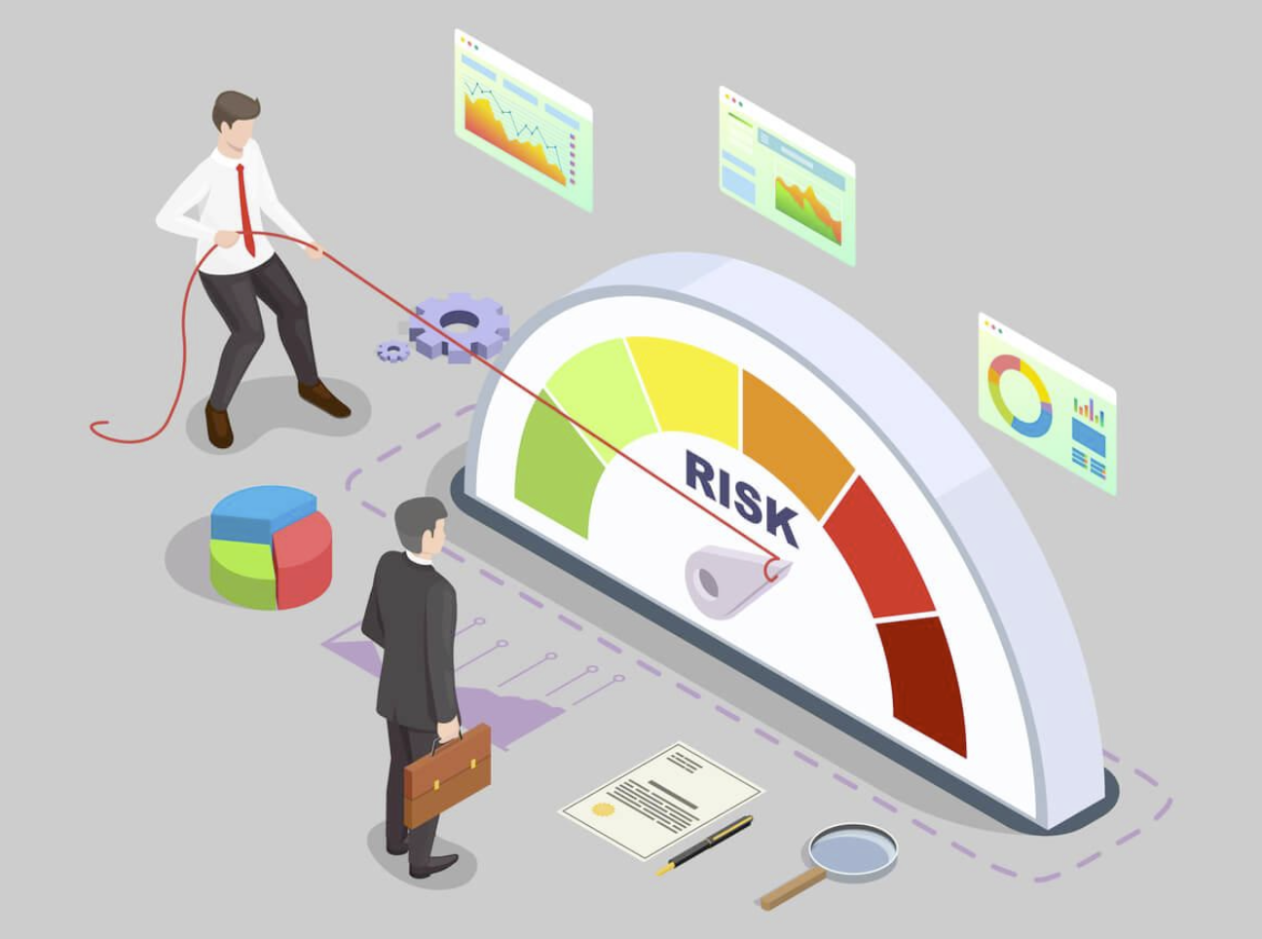
Risk Management
While committing to the agile method, there are a few ways the team has decided to avoid potential issues. Third Avenue software will maintain total control of operations by choosing not to outsource any work.
3 of the risks we’ve focused on include:
Quality/Payroll - Tracking operations to manage potential software bugs to avoid the need to spend extra time correcting potential mistakes.
Security - Prioritizing security to prevent potential data leaks.
Timeline - Meeting milestones in timely manner to complete project by due date

Slide 37
PART 7
Project Stakeholder Management

Slide 38
Stakeholders
“Team Green”
Product Owner
Eric
ScrumMaster
Jack
Third Avenue Regulatory Manager
Kendra
Quality Assurance Manager
Third Avenue Management
Users of the Healthcare App
Lia
Programmer
Barry
Accounting Staff
Aziz
Quality Assurance Tester
Brianna
Marketing Representative

Slide 39
Stakeholders Management Plan
Name | Power/Interest | Current Engagement
Team Green Product Owner | High/High | Leading
Eric ScrumMaster | Medium/High | Supportive
Lia Programmer | Low/Medium | Neutral
Brianna Marketing Representative | Medium/High | Supportive
Jack Third Av. Regulatory Manager | High/Medium | Supportive
Kendra Quality Assurance Manager | High//High | Leading
Aziz Quality Assurance Tester | Low/Low | Resistant
Barry Accounting Staff | Low/Medium | Neutral
Third Avenue Management | High/High | Resistant
Users of the Healthcare App | Low/Low | Unaware

Slide 40
Agile vs. Traditional: Stakeholders
Customer Engagement
Customer Collaboration
In Agile, customer engagement is at the very top. The customer is regarded highly in its frameworks
The agile approach prioritizes customer collaboration over contract negotiation
Continual Changes
Cost Saving
The stakeholders continually change items on the backlog which the team will respond to as new features and updates are added
Since the Agile approach encourages improvisions for customer feedback at every stage, restart costs are low, which helps save cost.
Transparency
The agile method encourages active participation and transparency between the stakeholders and the team

Slide 41
Issue Log Prepared by: Team Green
Issue # | Issue Description | Impact on Project | Date Reported | Reported By | Assigned To | Priority | Due Date | Status | Comments
1 | Need requirements categorized as mandatory and optional for MVP | Project cannot succeed without it | 7/15 | Eric | Product Owner | H | 7/19 | Closed | Completed in Part 2
2 | Need to clear the app for healthcare guidelines | The app cannot go public without compliance | 7/13 | Product Owners | Jack | H | 7/20 | Open | Collecting documents
3 | Need to test run app for payment security | Highly required for financial trust from consumers | 7/16 | Brianna | Eric | H | 8/25 | Open | In the process of contracting with a hosting platform
4 | Need budget progress reports to Third Avenue management after each Scrum | To monitor budget concerns for accounting and management | 7/11 | Third Avenue Management team | Barry | H | After each Scrum | Open | Budget progression continuously monitored throughout project
5 | Need to alphabetize medication list | Front end advantage | 7/16 | Lia | Lia | M | 8/16 | Closed | Completed
Etc.

Slide 42
Thank you

